Slide 1
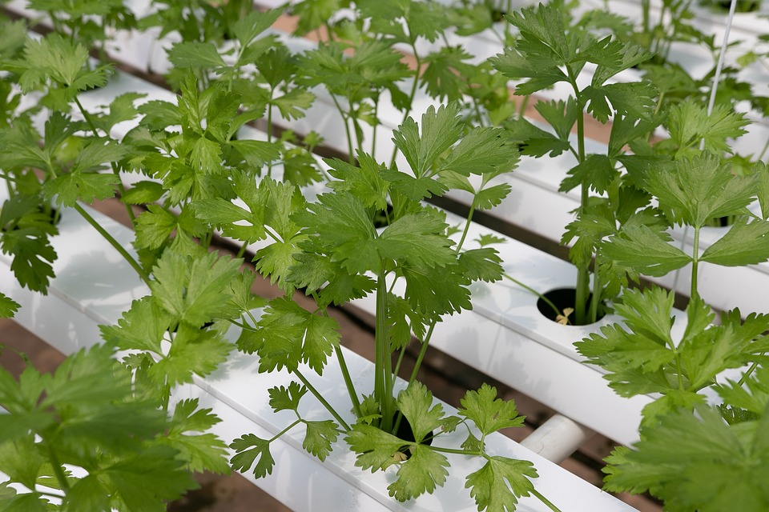

FERT PPM
Quality at its best
Created and presented by:
Benson Kingori
Stephanie Iman

Slide 2

TEAM MEMBERS
Benson Mwangi is a well-rounded developer with a passion for building efficient and user-friendly websites and applications which are powered by Artificial intelligence. He has extensive knowledge of backend, frontend development and machine learning, and is fluent in programming languages like Python, C/C++, HTML, CSS, and JavaScript and platforms like Django, Flask, TensorFlow, Keras, pytorch Tkinter and Neural networks.
Stephanie Iman is a highly technical and motivated individual with ambitions of coming up with very user-friendly platforms, be it applications or websites. She aspires to work on applications friendly to the disabled and lesser people in the community. She is well educated on Python and its libraries, CSS, HTML, Bootstrap, JavaScript as well as working with Rest API and is able to write Object Oriented code. In addition, she has knowledge in unit testing and database like MySQL

Slide 3
Source of inspiration
Prior to starting, we were in a pool of all these project suggestions that sounded really great as portfolio projects which included Chatbot and ADHD planner, until Benson who is one of the members of the team behind its creation suggested of FERT PPM. It was a work in progress app running in a desktop environment under development. Taking it up and reprogramming it into a web app has been a challenge and a good experience. It really helped that we learnt more from each other in both front and backend aspects.
We have so many ideas and visions of a fully functional marketable app that when combined together are the motivation of creating this app that can one day be put in a business setup and hopefully generate Revenue.

Slide 4
Technologies
- Languages: Python, HTML, CSS, JavaScript, Django template language, php
- Frameworks: Django, Flask, node.js
-Database: PostgreSQL + ORM concept
- Libraries: Bootstrap 4
- Platforms: Virtual environment, Amazon Web Services, VSCode,
- Hardware: Web Servers [Aws Elastic Beanstalk, Pythonanywhere], Application Server, databases [PostgreSQL Database aws], Firewalls, Load balancer.

Slide 5
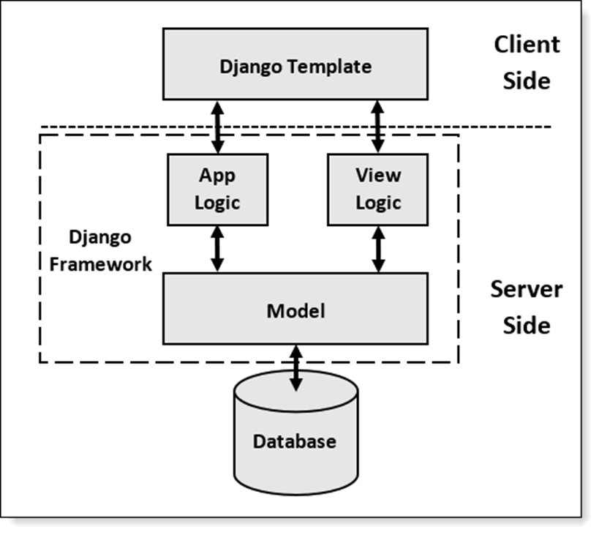
ARCHITECTURE

Slide 6
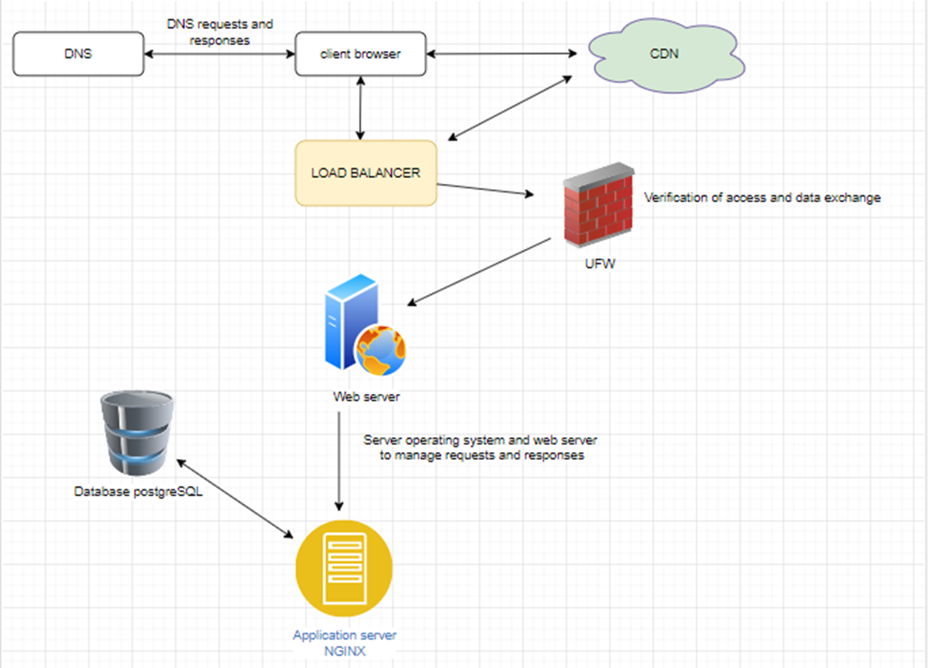
WEBSTACK ARCHITECTURE

Slide 7
ALGORITHM
By default, our system uses the algorithm: PBKDF2 algorithm with a SHA256 hash
a password stretching mechanism recommended by NIST. This is sufficient for our system users: it's quite secure, requiring massive amounts of com
puting time to break.
Raw passwords are not stored, so there is no way to see this user’s password, but user can change the password using any time they want.

Slide 8
breakdown(Core Algorithm)
1. MEDIA TYPE Hydroponics/Soil - ability to add new [Form]
2. Area of application [HA]
3. Injection ratio {Dilution ratio} form
4. Water usage m3 form
5. Date of usage [Filter data] form
6. Add Fertilizers and amount kg/ltr new. ui
7. Element composition in our fertilizer in no 6 EG CANO3 15.5 % NO3, MGNO3 = 11 % NO3
8. Fertilizer price/kg
9. Grams = no.6 / 1000
10. g/m3 [fertilizer amount kg/ltr no4( to give us g/m3 of the mixture) / Water usage m3 no4 [MODEL] views
11. ppm = g/m3 no.8 * elements % no.9 / 100
12. Lab test results
13. Lab recommendation

Slide 9
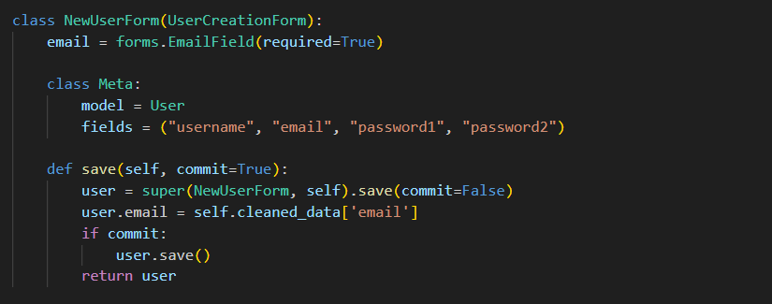
Code Snippet

Slide 10
Discussion of process
Our development process strategy involves automated continuous integration (CI/CD) and delivery processes. We use our special tools to automate building, testing, and deploying our application code. This ensures that the application is always in a deployable state and any changes are automatically deployed to the production environment. We have currently utilized pythonanywhere deployment platform servers to automatically pull our system from the github and rebuild it anytime changes are made from development environment

Slide 11
Discussion of collaboration
We have very big ambitions of future updates and features that will help our end users enjoy their experience while interacting hence collaborating with fertilizer brands with elements keyed in this project eg borax etc. would be a huge plus for us.
We also hope to include a QnA section where Agriculture experts get to answer the commonly asked questions.

Slide 12
T Discussion of timeline
We set the progress timeline to be one month to complete the project by completing planned tasks, staying within the coordinated project schedule, and successfully resolving issues. Considering the results of the second week, we had gone some place by building both core functions for both server side and client side. In the third week we have overcome challenges related to project dependencies, implemented dynamic sorting and filtering options and communication between the system, data and storage engines, as well as integrated file export functionality. We also made efforts to improve collaboration and communication with other developers. Despite some delays in schedule due to challenges faced, overall progress is on track.

Slide 13
Challenge(s) overcome
Multiple programming languages
Migrating the project from a desktop app to web application
Time limitation
The challenge associated with system database and web hosting service provider compatibility

